Slide 1
Focus Groups: A Strategic Tool for Discovery & Assessment
Bethany Truax

Slide 2
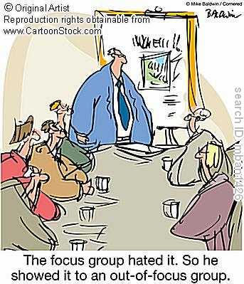

Slide 3
Assessment
Assessment: “any effort to gather, analyze, and interpret evidence which describes institutional, divisional, or agency effectiveness" (Upcraft and Schuh, 1996, p. 18)
Assessment is becoming continually more prominent in higher education
Programs
University
Parents
Conferences
Qualitative v. Quantitative

Slide 4
Focus Groups are NOT
Therapy Groups
Planning Committees
Nominal Groups
Naturally Occurring Groups

Slide 5
Focus Groups Are
“Peer conversations” (Morgan, 1988, p. 77)
Moderator
“Provide higher quality and greater richness of information
because of shared opinions, ideas, and discussions of a small
group who have similar experiences [and an in-depth
understanding]” (McMillian 1989, p. 8)

Slide 6
Advantages
“Voice” (Upcraft & Schuh, 1996)
Collaboration
More energy
Attention to language
Time efficient
Qualitative data

Slide 7
Disadvantages
Lack of rapport
Discomfort
Competition for “air time”
Shyness
Lack of control
Only 60-70% of ideas shared
(Fern, 1982)

Slide 8
How-to: Focus Groups
8-10 students
Over-recruit
Incentive
The participants need a shared characteristic
i.e. they are all students at the university
Strangers
Meet for 2 hours or less
Record session
Gamon, J. (1992). Focus groups-a needs assessment tool. Journal of Extension, 30(1).

Slide 9
How-to: Focus Group
Tips:
Be strategic when deciding on a heterogeneous group or a homogeneous group
Smaller groups tend to yield more results when discussing emotional issues
Larger groups tend to yield more results when discussing a neutral topic
Quality data depends on a number of factors: whether the researcher gathers enough participates, selects appropriate samples, chooses relevant questions, has a qualified moderator and uses an effective analysis strategy (Morgan, 1995)

Slide 10
Focus Groups in Student Affairs Assessment

Slide 11
The End

Slide 12
References
Fern, E.F. (1982). The use of focus groups for idea generation; the effects of group size,
acquintanceship and moderator on response quality and quantity. J. Mark. Res 19:1-13.
McMillian, J.H. “Conceptualizing and assessing college student values.” Paper presented at the aunual meeting of the American Educational research Association, San francisco, Mar. 1989.
Gamon, J. (1992). Focus groups-a needs assessment tool . Journal of Extension , 30(1).
Morgan, D. L. (1996). Focus groups. Annual Review of Sociology, 22, 129-152.
Morgan, D.L. Focus groups as Qualitative Research. Qualitative Research Methods, no. 16. Newburry Park, Calif.: Sage, 1988.
Upcraft, M. L., & Schuh, J. H. (1996). Assessment in student affairs: A guide for practitioners. San Francisco, CA: Jossey-Bass.

