Slide 1
Assessing Student Learning Outcomes
Andrew Swan

Slide 2
What are Student Learning Outcomes?
Education reform in the 1990s pushed for more sophisticated goals that emphasized for student knowledge acquisition outside the realm of traditional subject matters (Marzano, Pickering, and McTighe 1993)
Student Learning Outcomes “describe specific behaviors that a student of your program should demonstrate after completing the program” (Wuest & Garza, 2006)

Slide 3
What should Student Learning Outcomes cover?
Student Learning Outcomes should measure:
Core knowledge and skills that are developed throughout the program’s curriculum (Lindholm 2009)
When developing Student Learning outcomes, consider:
What is expected from a graduate of the program?
What should the student know or be able to do as a result of your program?
What should a student from your program care about? (Wuest & Garza, 2006)

Slide 4
What should Student Learning Outcomes cover?
Overall, your Student Learning Outcomes should be based on the mission and goals of your program; after all, they are meant to help you measure if you are doing what your department or program has set out to do

Slide 5
Purpose of Student Learning Outcomes
Isn’t student learning already measured in the classroom?
Grades aren’t a true measure of a student’s performance and knowledge – one student with a C may perform very differently from another C student.
Assessment of student learning outcomes measures a student’s grasp of knowledge and skills, providing more meaningful feedback to students, instructors, and the school community (Marzano, Pickering, and McTighe 1993)

Slide 6
Purpose of Student Learning Outcomes
Can serve as a basis for program improvement
Can shape curriculum, how courses are designed, and how courses are delivered by instructors
Communicate purpose to students and parents
Can be used as promotional materials and advising material
Assist in accreditation (Wuest & Garza, 2006)

Slide 7
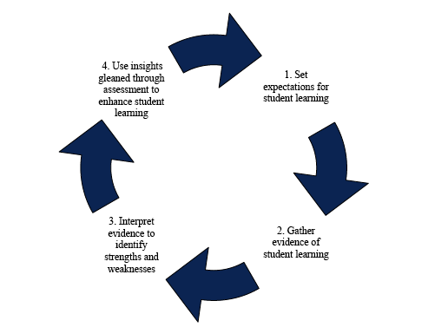
Assessing Student Learning Outcomes – The Basic Cycle
(Lindholm 2009)

Slide 8
Developing Assessing Student Learning Outcomes
An assessment plan should provide “an objective means of supporting the outcomes, quality, efficiency, or productivity”
When designing an assessment plan for Student Learning Outcomes, your plan should
Be designed to generate meaningful evidence that can be easily evaluated
Be manageable in scale and scope
Be adaptable
Based on a timeline to keep your assessment cycle on schedule; when will you assess your outcomes?

Slide 9
Assessment Methods – Direct vs. Indirect
Direct Assessment Methods…
“The assessment is based on an analysis of student behaviors or products in which they demonstrate how well they have mastered learning outcomes.” (Allen, 2008)
Indirect Assessment Methods measure…
“The assessment is based on an analysis of reported perceptions about student mastery of learning outcomes.” (Allen, 2008)

Slide 10
Assessment Methods – Direct vs. Indirect
When assessing student learning, direct methods focus on evaluating the measurable competence of students
This can be done through exam scores, portfolios, observation, or activity logs; any behavior that directly observes or measures student performance
On the other hand, indirect methods focus on the perception of student competence
This can be done through surveys, interviews, or focus groups

Slide 11
Assessment Methods – How do you choose?
Can depend on what you want to measure; what is “best” for one outcome will not be appropriate for all outcomes
However, all good assessment techniques share certain properties
They are valid and reliable
They provide evidence that can be acted upon
They are efficient and cost-effective
They engage students, faculty, and stakeholders

Slide 12
Example
You work in a career services office, and you want to measure the following outcome:
“Students using the services offered at the Career Services center will be equipped with the appropriate skills to undergo a successful job search.”

Slide 13
Example
You decide to measure this outcome by administering a survey to alumni that used services offered your office; this survey asks them to rate how prepared they felt for job interviews . You set your benchmark score at 90%
Only 75% of respondents felt that your services adequately prepared them for the rigors of job searching; however, your original survey does not provide information as to where alumni felt that they were unprepared

Slide 14
Example
So, you re-design the survey to allow for more open-ended feedback in order to better assess which of your practices are working, and which ones are not.
This example encompasses all steps of the assessment cycle; you set an expectation, gather evidence to see if you’re meeting expectations, use that evidence to inform your future actions, and then further refine your assessment methods and restart the process anew.

Slide 15
Conclusion
Student Learning Outcomes are an integral part of all university work, whether it’s classroom curriculum, university services, or programming.
Effective assessment of student learning outcomes not only helps you measure how well you are serving your students, but how you can further improve the services you offer.

Slide 16
Works Cited
Allen, Mary J. (2008). Strategies for Direct and Indirect Assessment of Student Learning. Retrieved from: http://assessment.aas.duke.edu/documents/DirectandIndirectAssessmentMethods.pdf
Garza, L, & Wuest, B. (2006). Methods for Assessing Student Learning Outcomes. Presentation, Texas State University. Retrieved from http://gato-docs.its.txstate.edu/university-planning-and-assessment/internal-UPA-Presentations/Methods-for-Assesing-Workshop/Methods%20for%20Assessing%20Workshop.ppt
Lindholm, Jennifer. (2009). Guidelines for Developing and Assessing Student Learning Outcomes for Undergraduate Majors. Retrieved from: http://www.wasc.ucla.edu/eer_endnotes/Learning_Outcomes_Guidelines.pdf
Marzano, R. J., Pickering, D., & McTighe, J. (1993) Assessing Student Outcomes: Performance Assessment Using the Dimensions of the Learning Model. Alexandria, VA: Association for Supervision and Curriculum Development.

