Slide 1
Understanding the Need For Alcohol Assessment in College Students: An Overview
Nikki Eversole
CNS 610
Western Kentucky University

Slide 2
Nikki Eversole
King College
Bristol, TN
Class of 2010
Bachelors of Arts in Sports Management with a Minor in Coaching
Western Kentucky University
Bowling Green, KY
Full Time Housing & Residence Life Professional
Pursuing a Masters of Arts in Education in Student Affairs.

Slide 3
Objective
A quick overview of college students drinking habits
University Drinking Policies and Sanctions?
How can we assess what students are retaining from these alcohol sanctions?
How can assessing the alcohol use of college students impact your college or university?

Slide 4
Is College Student Alcohol Use a Problem?
Let’s look at the following
Death
Injury
Unsafe Sex Academic Problems
Health Problems
With high numbers like these what are College Administrators doing to educate students about responsible drinking?

Slide 5
Alcohol on Campus
Dry Campus
NO ALCOHOL IS PREMITTED ON CAMPUS OR IN RESIDENCE HALLS, REGARDLESS OF AGE OR EVENT
“Moist” Campus
ALCOHOL IS PREMITTED IN CAMPUS APARTMENTS, OR SPECAIL EVENTS WITH PRIOR APPROVAL
Wet Campus
STUDENTS MAY DRINK ON CAMPUS IF THEY ARE OF AGE, AND FOLLOW THE COMMUNITY STANDARDS.

Slide 6
Tennessee Tech University
Dry Campus
According to the Tennessee Tech University Student Code of Conduct, “The use, possession, distribution, sale, or manufacture of alcoholic beverages, or public intoxication on TTU owned or controlled property, at a TTU sponsored event, or property owned or controlled by an affiliated clinical site is prohibited” (TTU, 2011)
Possible Sanctions: Warning, Community Service, Reprimand, or Alcohol and Drug Counseling

Slide 7
Western Kentucky University
“Moist Campus” – Alcohol is not allowed on campus, with the exception of home football games when students who are over the age of 21 can consume alcohol prior to kickoff.
Western Kentucky University has a “Three Strikes” Alcohol Policy. (WKU, 2011)
According to the Student Code of Conduct…
“If you are under 21, it is against the student code of conduct for you to drink.”
“It is against the student code of conduct for anyone to buy alcohol for someone under 21.”
“It is against the student code of conduct for anyone to be drunk in public or to drive while drunk.”
“It is a violation of the student code of conduct for your drunken behavior to disturb someone else’s ability to sleep, study, or live peacefully.”
“It is a violation of the student code of conduct for you to hurt or endanger yourself or someone else through drinking.”

Slide 8
Western Kentucky University
Possible Sanctions
“1st Strike”… Written disciplinary agreement and an educational experience
“2nd Strike”… Probation and an educational experience
“3rd Strike”… Separation or suspension from the University
All of the these sanctions are likely, but each offense is treated on a case by case basis. (WKU, 2011)

Slide 9
The University of San Diego
Wet Campus
According to the Campus Alcohol policy, “Possession and consumption of alcohol is permitted by persons 21 years of age or older only in private rooms within University residence halls, where at least one assigned resident is 21 years of age or older, except as noted below. Possession, consumption and storage of alcohol is prohibited in all residential common areas, eg. lobbies, public lounges, hallways, stairwells, common bathrooms, landings, common kitchens, balconies, patios, closets or outdoor areas.” (USD, 2012)
Possible Sanctions: Warning, Educational Sanctions, Fines, Loss of Privileges

Slide 10
How Do You Assess College Drinking?
There are several different methods for assessing the use of alcohol in college students.
Electronic Assessments, (i.e. eChug)
Campus Wide Surveys such as The American College Health Association’s National College Health Assessment
Assessments administered during alcohol sanctions or programs. (i.e. WKU’s Alcohol 101)

Slide 11
eChug
Created by counselors and psychologists and San Diego State University.
Used by over 550 colleges and universities world wide
Intended to be use as an interventional tool

Slide 12
eChug Alcohol Assessment

Slide 13
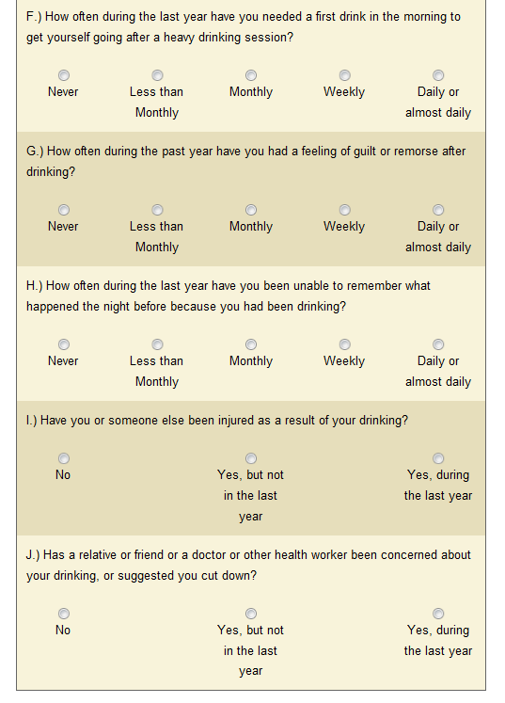
eChug Alcohol Assessment

Slide 14
eChug

Slide 15
National College Health Assessment
Partner with the American College Health Association (ACHA)
Can be paper based or electronic
Also assesses a broader range of health topics in college students.

Slide 16
Alcohol 101
Creative Sanctioning at Western Kentucky University.
Two hour class
Asks students to reflect on their drinking habits, and teaches them responsible drinking behaviors.
Includes a 3 page reflection paper.

Slide 17
Assessment Cost
National College of Health Web Based Survey
0.43 for each student who takes the survey
Initial survey contacts/email invitations
Up to 3 student follow up contacts
Processing all survey submissions
Institutional Data File in SPSS
Institutional Data Report
Institutional Executive Summary
Reference Group Data Report
Reference Group Executive Summary

Slide 18
Assessment Costs
National College of Health Paper Based Survey
Scan Forms $0.40 each
Survey Processing/Scanning Fee $0.50 each
Reports Package $300
Institutional Data File in SPSS
Institutional Data Report
Institutional Executive Summary
Reference Group Data Report
Reference Group Executive Summary

Slide 19
Assessment Costs
eChug
One year subscription $975
Alcohol 101
The time it takes to plan out, research, and put the presentation together.
Two hours of your time to teach the class.

Slide 20
Implications
It would be unreasonable to believe that college students do not drink alcohol.
By assessing the need of alcohol education on your campus, you can better improve your alcohol education programming.
Improving these programs will reduce the number of alcohol related incidents on your campus, while educating your students on responsible drinking.
If using the assessments presented in this podcast saves even one of your students from an alcohol related incident, the price is invaluable.

Slide 21
References
American College Health Assoscation. (2009). Acha-ncha data. Retrieved from http://www.achancha.org/
College Drinking Prevention. (2010, August 01). A snapshot of annual high-risk college drinking consequences. Retrieved from http://www.collegedrinkingprevention.gov/statssummaries/snapshot.aspx
Sickle, D. V. (2009). eCheckup to go. Retrieved from http://www.echeckuptogo.com/usa
Tennessee Tech University. (2011). Student conduct and disciplinary sanctions. Retrieved from http://www.tntech.edu/ttustudenthandbook/studentconducts/
University of San Diego. (2011). USD: Student conduct . Retrieved from http://www.sandiego.edu/conduct/the_code/sanctions.php
Western Kentucky University. (2011). Western kentucky university's alcohol policy. Retrieved from http://www.wku.edu/judicialaffairs/plain-english-alcohol-policy.php

Slide 22
Thank You
Please forward all questions about todays Podcast to nikki.eversole@wku.edu

