Slide 1
Sharing Insight and Experience from an Alma Implementation
Mike Rogers
University of Tennessee
Keynote Address, eBUG 2015 – Lexington, KY

Slide 2
For today’s talk…
UT Library and our path to Alma
Overview of Alma implementation process
Tips for staying sane during implementation
Pros/Cons of moving to Alma
Final Thoughts – now and the future

Slide 3
UT Library and our path to Alma

Slide 4
University of Tennessee Library:
One main library, three branch libraries
150 library staff (48 faculty librarians)
Serves 26,000+ students, 9,000+ faculty/staff
UT Medical Library holdings are in catalog
On-campus storage facility

Slide 5
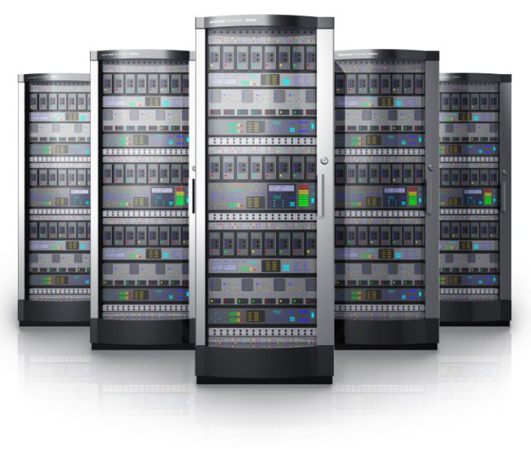
Enterprise Systems Prior to Alma
Aleph
Implemented Fall 2003
Primo
Implemented Fall 2009
SFX
Implemented Fall 2002
ILLiad
Implemented pre-2000

Slide 6
Systems mindset dilemma: Early adoption vs. behind the curve?

Slide 7
2013 – the year it started
Administrative push to cease server hosting
Departmental restructuring
Enterprise Systems integrated with Technical Services to become “Discovery & Technical Services”
Maribeth Manoff (Dept. Head) charged by Dean to investigate next-generation library systems
April 2013 – Carl Grant visit to UT Library
May 2013 – ELUNA, Athens GA
July & August – In-house demos of ExLibris’ Alma and OCLC’s Worldshare Management Services
Sep through Dec – RFP for new system

Slide 8
Spring 2014
January
signed contract w/ ExLibris for Alma
Met w/ ExLibris Sales and Professional Services staff at ALA Mid-winter
Began reviewing “Getting Ready for Alma” doc
April
Pre-kickoff meeting
Filled out & submitted Alma Implementation form
Appointed Implementation team members
Met briefly with ExLibris staff at ELUNA (Montreal)
May
Exchanged some emails w/ ExLibris project manager

Slide 9
June 12, 2014 – Kickoff Meeting!
WebEx phone call between ExLibris and University of Tennessee

Slide 10
Overview of Alma Implementation Process

Slide 11
UT Project Team
Project Manager
Technical Lead/Overall Data Expert
Data Expert, Acquisitions & E-Resources
Data Expert, Fulfillment
Data Expert, Resource Management
Functional Expert, Acquisitions (2)
Functional Expert, E-Resources (2)
Functional Expert, Fulfillment (2)
Functional Expert, Resource Management
Functional Expert, Primo

Slide 12
ExLibris Project Team
Project Manager
Alma Implementation Consultant
Alma Technical Lead
Alma “Knowledge Guru”
Primo Consultant
Infrastructure Consultant
Various Alma, Primo, & Networking Experts

Slide 13
Communication methods
Basecamp
Project management software (desktop & mobile)
Topical threads
Document storage
Weekly status phone calls
WebEx
E-mail (lots of email…)
Phone calls
Two on-site visits
Configuration Form overview
2 day Alma Workshop

Slide 14
In spite of all these communication methods, the lack of face-to-face communication can be difficult during the implementation process

Slide 15
UT’s schedule:
Six month process from Kickoff Meeting to Go-Live
Weekly status phone calls between site & ExLibris
Ongoing recorded trainings and Q&A for first 3 months
Sandbox access provided early on
Migration Form, P2E file, 1st Auto-extract due approx. five weeks after Kick-off
Onsite configuration meeting July 21-22
Configuration form due August 8

Slide 16
UT’s schedule (cont.)
Test load / production env. delivered August 18
Primo delivered for testing September 15
Data checking August – October
Ongoing data clean-up in old system (e.g. Aleph)
Certification training during month of November
Cutover activities and final data extraction during December 8-17
Go Live December 18

Slide 17
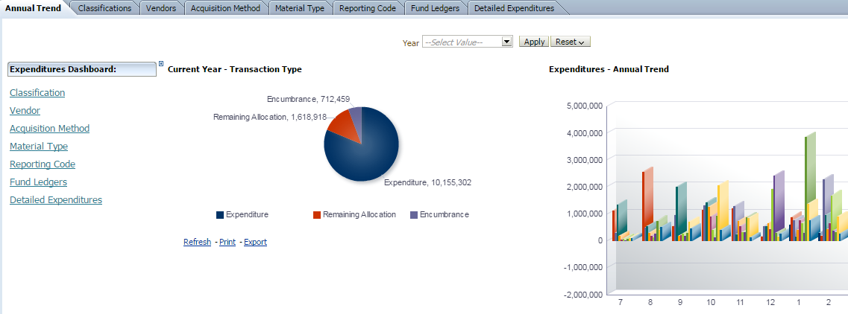
Alma Reports & Analytics Training
WebEx Training Session (not on-site)
UT had multiple attendees
ExLibris trainer was excellent, with very relevant material
2 days:
Day 1 – Strategies and techniques for using Alma to perform record batch work, data cleanup, etc
Day 2 – Analytics reporting
Training occurred in the 3rd month of our Implementation

Slide 18
Certification Training
In-depth online training for Alma administrators
UT had four staff receive training
4-weeks:
Week 1 – User management (~3 hours videos)
Week 2 – Fulfillment (~10+ hours of videos)
Week 3 – Resource Management (~6+ hours videos)
Week 4 – Review & Exam
Training occurs near the end of 6-month implementation
Once certified, staff are allowed access to Alma configuration

Slide 19
Feedback on Training & Certification
Training is very in-depth, very helpful
Primary trainers are excellent
Connie Braun (Reports & Analytics)
Shmuel Moss (Certification)
Overall we learned a LOT
but …
Strong consensus was that Certification Training should have occurred much earlier in process
Felt that Analytics training would have been more helpful towards the end of the Implementation process

Slide 20
Final Cutover & Downtimes
Technical Services: December 7 – 17
11 days downtime
Fulfillment (Circulation): December 16 – 17
2 days downtime
Staff used Offline Circulation

Slide 21
Trivia Time #1!
Name the U.S. state where both Abraham Lincoln (President of the Union) and Jefferson Davis (President of the Confederacy) were born?
Answer:
*they were born less than 100 miles and one year apart

Slide 22
Tips for Staying Sane During Implementation

Slide 23
Tip #1 – Begin working prior to the Kick-Off Meeting

Slide 24
What to do prior to kickoff?
Learn as much as you can about Alma
Ask other Alma customers
Push ExLibris for as much information as you can get
Start data clean-up (consult colleagues, work with pre-Implementation Consultant)
Communicate with library staff
Map out workflows
Stay calm!

Slide 25
Tip #2 – Change your mindset about the concept of “implementation”

Slide 26
Very Important to Understand…
“Go Live” does not mean 100% implementation
Rather, you are simply running Alma in live mode, performing bulk of work on new system
Three system migrations in one
Integrated Library System (ILS)
Discovery system (Primo)
Link Resolver

Slide 27
Comparison of system migrations (UT):
Geac to Horizon (1997) – 6 months
Horizon to Aleph (2003) – 8 months
SFX (2002) – 1 to 2 months
Primo (2009) – 6 months
Aleph/SFX/Primo to Alma/Primo – 6 months
Result = Very complex migration in limited amount of time!

Slide 28
Tip #3 – Expect the unexpected

Slide 29
Things can and do go wrong during Implementation
Unexpected data migration issues
Staff departures
Misunderstandings between site and ExLibris, e.g.
Scheduling differences
Communication about deliverables
Server crash on legacy ILS, causing an Oracle array puncture and loss of data right in the middle of Implementation, requiring 2 weeks recovery
Yes, this happened to us!

Slide 30
Tip #4 – Acknowledge progress made and milestones reached … and take time out for “breaks”

Slide 31
*Project Manager purchased T-shirts to celebrate a successful implementation

Slide 32
Find your stream ….
…. and relax

Slide 33
Tip #5 - Give constructive feedback to ExLibris as necessary

Slide 35
Constructive feedback can include:
What is/isn’t working well
Suggestions for improvement
What your expectations were, and how the outcomes differed
*Feedback can be very beneficial both to ExLibris (as they improve the migration process) as well as future Alma customers (who benefit from the improvements made).

Slide 36
Ultimately …
ExLibris wants your project to succeed just as much as you do

Slide 37
Tip #6 – Remind your staff (and yourself) to take things one day at a time

Slide 38
Although it feels like a sprint, implementing Alma should be treated like a marathon

Slide 39
Trivia Time #2!
During the 1970s, three different horses won the Triple Crown. What were the names of the three horses?
Answer:
Secretariat (1973)
Seattle Slew (1977)
Affirmed (1978)

Slide 40
Pros & Cons of Moving to Alma

Slide 41
Pros
Cloud-based, multi-tenancy system
No more hardware or server maintenance
Web access means no GUI clients to install/maintain
No more version upgrades, service packs, or hot packs performed by the customer
Much more rapid update process (monthly)
No more re-indexing by site
Little to no downtime
Apart from routine overnight maintenance, we’ve experienced zero downtime in the past seven months

Slide 42
Pros (cont.)
Essentially eliminated after-hours “on call” for systems staff
Alma as a system seems very integrated
Move away from a modular-type system
Integrated workflows
Integrated Analytics: can embed custom reports into user dashboards
Excellent record loading functionality
Powerful and flexible loading templates
Scheduling
Good match profiling

Slide 43
Pros (cont.)
Very active and helpful user community
Community Zone – much future potential
Ongoing updates to e-resources
Shared cataloging records
APIs available for creating custom read/writes to the data
Many results screens in Alma allow for direct Excel dumps
Our experience with Alma Support has been very positive

Slide 44
Pros (cont.)
Integrated Analytics provides much better reporting capabilities
Much better integration with Primo
OPAC via Primo
Customized request screen using a “Discovery Skin”
User’s loan policy details appear after sign-in
OpenURL links to ILLiad for Interlibrary Loan requests
Normalization rules for cataloging updates and record loading are powerful and accessible to staff
Often a very good exercise to re-evaluate library processes & workflows in the context of a migration

Slide 45
Cons
It is a LOT of work to migrate
Essentially migrating your ILS and Link Resolving system to Alma
Implement (or re-implement) Primo
Much work beyond 6 month migration period
Pricing is expensive
As a “young” system, some functionality and/or workflow options still missing from Alma
Must wait on enhancement process to see significant system changes driven by customers

Slide 46
Cons (cont.)
No more direct access to back-end database
Learning curve for administrators & staff
Potential for stress amongst individuals, departments, etc. due to change
Third-party integrations are not well integrated … onus on customer to configure these
SAP
Banner
Patron import

Slide 47
Cons (cont.)
Alma error messages often terse and unclear; system troubleshooting by customer is limited
Probably by design, but customers used to solving problems more quickly on their own are now more dependent on SalesForce
Limitations in Analytics hamper certain reporting situations
Limitation on # of input rows for a query
Limitation on # of rows exportable to Excel
Certain system jobs are not flexible when it comes to scheduling

Slide 48
Pros or cons? You decide.
No more traditional printing in Alma
All printing is done through e-mail
Alma Configuration setup is an ongoing process
We are still configuring Alma 6 months past implementation
Strongly encouraged to setup loan rules “fresh” rather than trying to replicate legacy rules in Alma
Good way to eliminate duplication in codes/setup
Means more work at beginning

Slide 49
Final Thoughts: Where are we today? What is in store for the future?

Slide 50
Today we are:
Cleaning up migration problems
Preparing for first fiscal year rollover
Re-implementing 3rd party integrations
Alma-to-SAP (invoice transfer)
Alma-to-Banner (holds & fines transfer)
Working with subject librarians on custom reports
User-centered custom programs
Carrel reservation system
New books pages
Creating a missing items workflow

Slide 51
Future work includes:
Leveraging the community zone for shared cataloging
Authority control
Greatly increasing Analytics reporting
ARL stats
Campus reports
Better integration between Alma & ILLiad (NCIP protocol)
Gathering feedback on patron enhancements and custom programming

Slide 52
But I wonder … what will it look like for a site to migrate from Alma to another vendor’s system?

Slide 53
In summary:
Alma is an amazing system with a ton of potential
Alma is expensive and a lot of work to implement … but we felt it was worth the effort
Our systems unit has been freed up from general systems overhead and maintenance tasks in order to focus more on patron and staff needs
Sites considering Alma should carefully weigh the pros and cons, and gather feedback from existing customers

Slide 54
Thank you for your attention!
Any questions?
mikerogers@utk.edu

