Slide 1
College of Health and Human Services International Service Learning Program
Gales Point, Belize

Slide 2
Ideology of Service Learning
Based on two ruling principals:
Moral responsibility to give back to society
Someone somewhere paid for your education
Knowledge from the classroom should be implemented so we can learn in the process
Theoretical constructs of the classroom and then implement them in the real world

Slide 3
Identifying Issues
We do not assume to know what they need and what their problems are
We ask what we can do to improve their quality of life
We work on what they ask, what they want, and what they think they need
Not what we think they need

Slide 4
Gales Point, Belize

Slide 5
Improving Quality of Life
Village stated you can live and die in Gales Point and never see a doctor
Univ. of Louisville sent a medical team
Handed over to WKU, we send medical and dental hygiene team
Medical team learns infants die once off breast milk and move to formula
Problem is cause by contaminated water

Slide 6
Nursing Team
Leigh Lindsey (RNP), Jayme Davis (BS), Amy Gurda (BS), Jaime Jones (BS), Katherine Krutza (BS), Jessica Mitchell (BS), Sarah Moesner (BS), Emily Morse (RN)

Slide 7
Dental Hygiene Team
Dr. Daniel Carter (DDS), Bonny Petty (Dental Hygienist), Erin Bertone (BS), Laura Payne (BS)

Slide 8
Public Health and Environmental Services Team
Ritchie Taylor (PhD), Molly Calico (MPH), Matthew Hill (MPH), Carrie Robin Menapace (MPA), Jordan Norris (MPH), Shabbar Ranapurwala (MPH)

Slide 9
Goals
They are aware of the problem
“Gales Point is knowledge rich, but resource poor.”
We need to empower them to create long term change
The Belize team this year decided we had five main goals
Medical Care and Health Education
Dental Prevention and Care
Central Water Treatment
Education about the problem and behavior that contributes
Government knowledge, reform, and cooperation

Slide 10
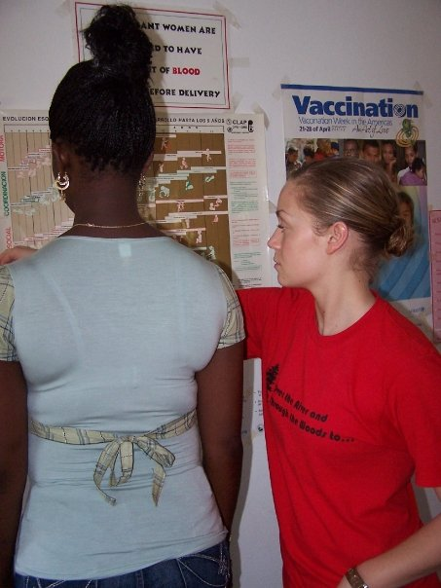
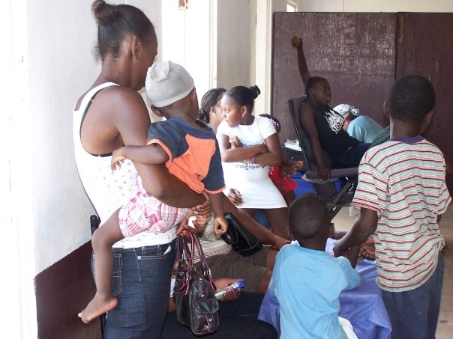
Medical Clinic
Every person in Gales Point receives a physical
Nursing students assist doctors in treatment
Pharmacy distributes enough medication for 365 days for specific ailments
Sometimes we are the only medical treatment they receive in a year

Slide 11
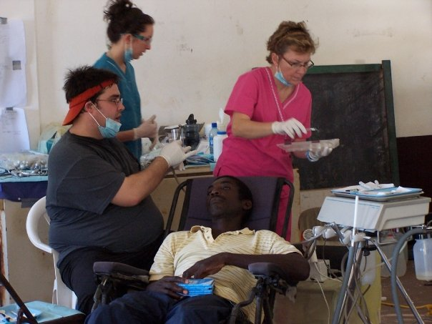
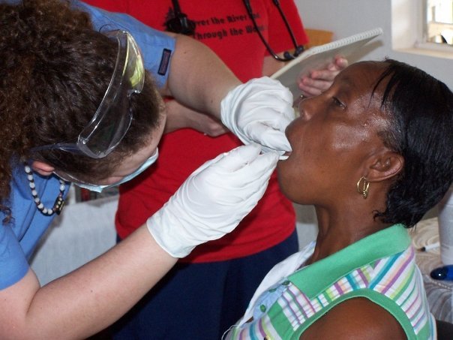
Dental Care
Dental Hygienists do yearly cleanings
Extractions and major dental work is completed
Distribution of dental products for the year
Cross discipline – all students help in all areas of the clinic

Slide 12
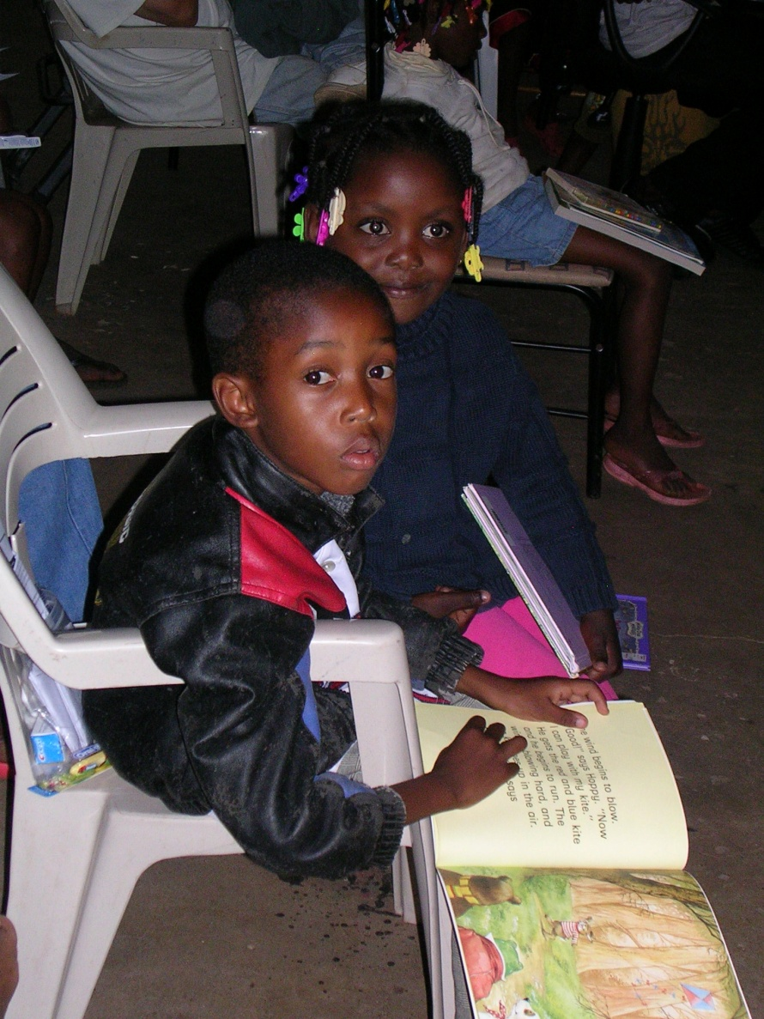
Education

Slide 13
Community Night
Ask the Doc!
Illness prevention and management information
Dental demonstrations
Water contamination explanation – Perceptions of community Research
In-home water treatment

Slide 14
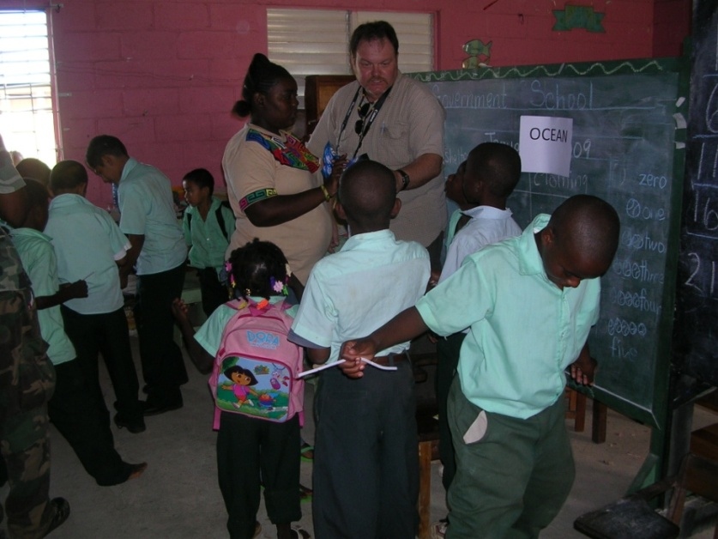
Gales Point Government School
Met with Principal to identify school needs
Importance of Environmental Education to the area
Working with sanctuary
Future curriculum development

Slide 15
Plant the Seed for the Future

Slide 16
Water Treatment

Slide 17
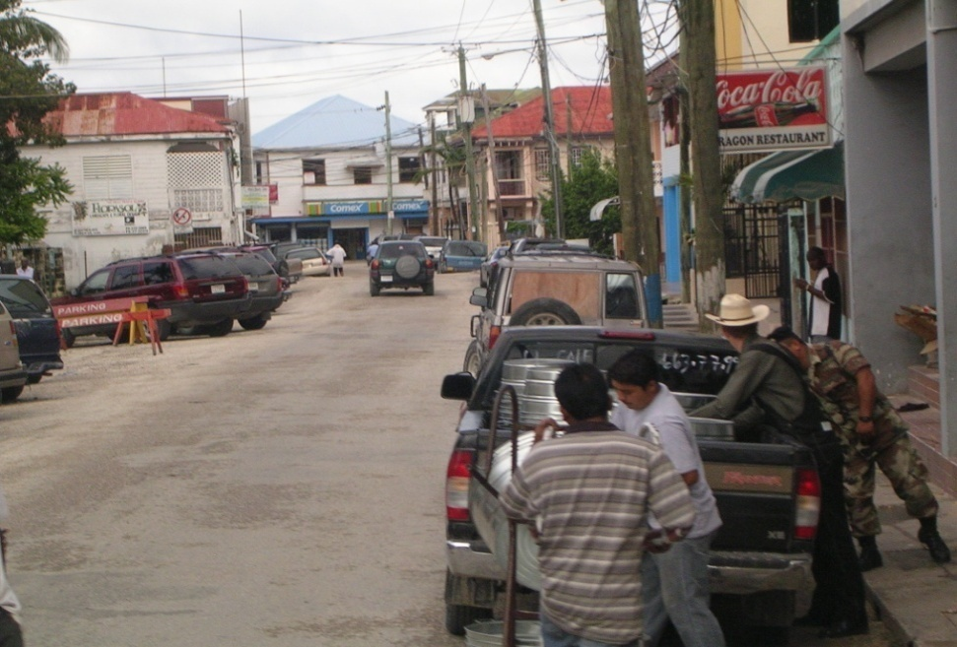
Government and Community Cooperation
Met with the Head of the Water Department in the Ministry of Health
Work out responsibilities of Gales Point and the Ministry
Discussed bureaucracy of water policy

Slide 18
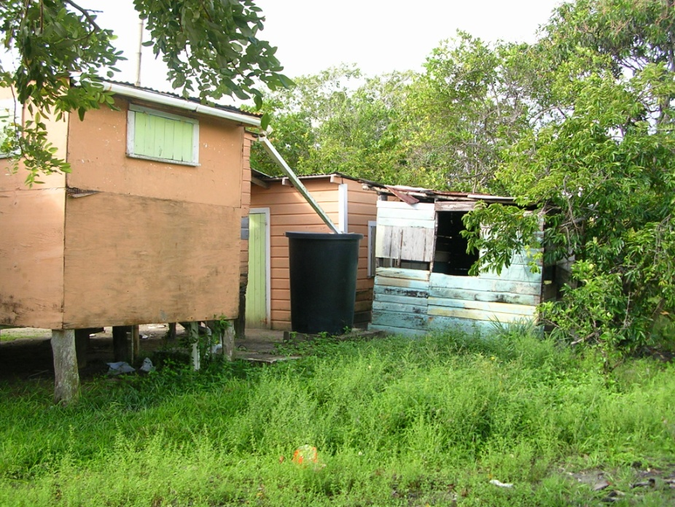
Building a Better Future

Slide 19
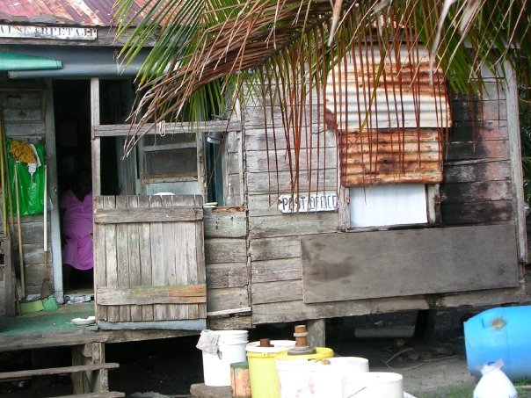
A Model Community
Central treatment – Country wide plan
Rural Community Development
Ministry of Health
In-home treatment methods
Behavior Practices
Sanitation
Septic Systems
Waste Disposal
Community mapping
Identify Problems
Perceptions

Slide 20
Interdisciplinary Learning
More disciplines
Environmental Education
Political Science
Linguistics
Anthropology
Agriculture

Slide 21
Reflective Learning
A.K.A.
Dock Time

