Slide 1
Accessibility and Teaching Online
Beth Case
Program Manager for Digital, Emerging, and Assistive Technologies
University of Louisville, Delphi Center

Slide 2
Disability Laws
Americans with Disabilities Act (http://www.ada.gov/)
Section 504 of the Rehabilitation Act (http://www.hhs.gov/ocr/civilrights/resources/factsheets/504.pdf)
Section 508 of the Rehabilitation Act (http://www.section508.gov/)

Slide 3
What Does this Mean?
Must be accessible without waiting for a request.
Access, not success, is guaranteed.
We do the best we can, good faith effort.

Slide 4
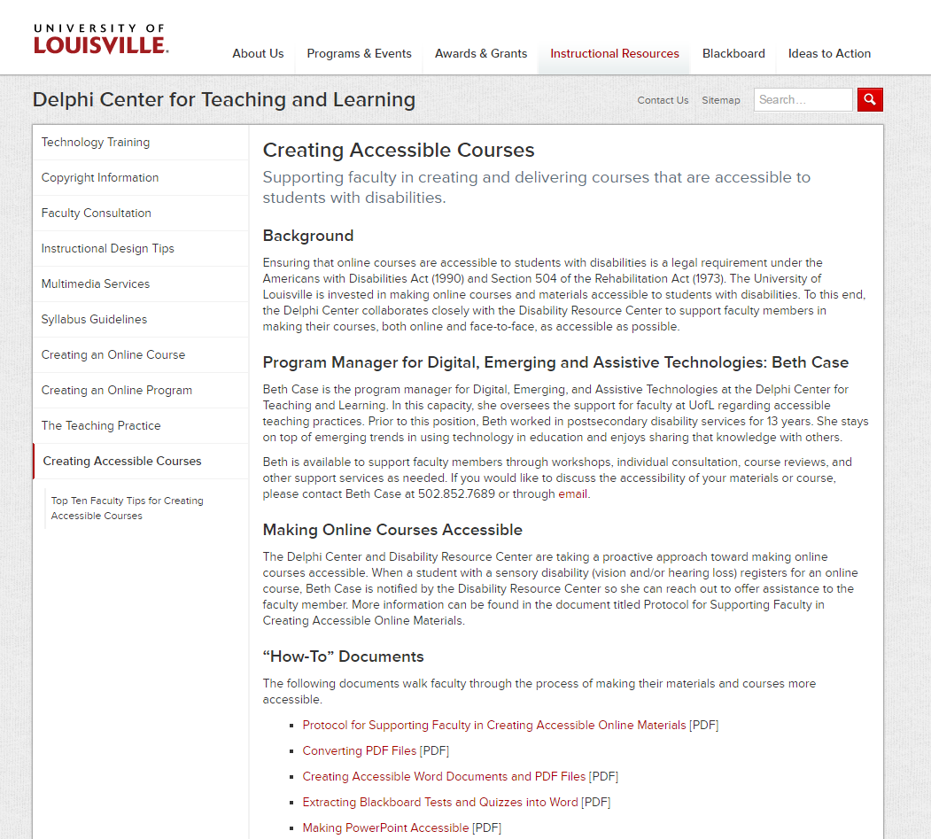
Creating Accessible Courses
Creating Accessible Courses website:
http://louisville.edu/delphi/resources/creating-accessible-courses

Slide 5
Word Documents

Slide 6
Word Documents - Styles
When creating a word document, use styles instead of bolding or changing font size.
This way, screen readers can tell which phrases are headings or titles and which are part of a paragraph.

Slide 7
Styles
Highlight the text you want to apply the style to.
Choose the Home tab.
Choose the Style you want to apply. In the above example, it’s the Heading 1 style.

Slide 8
Styles
There are a number of pre-formatted Styles you can use to change the appearance of your document. To see them, choose the Design tab.

Slide 9
Word Document - Alternate Text
Alternative Text (Alt Text) provides screen readers with text describing the picture.
What’s the point that you want the student to get from looking at this picture?
Leave out irrelevant details
http://louisville.edu/delphi/resources/creating-accessible-courses

Slide 10
Screen Reader Demo

Slide 11
How would you describe this picture if:
This is Dr. Jones, instructor.
This is an ad for men’s clothing.
This is an ad for “Hair Club for Men”.

Slide 12
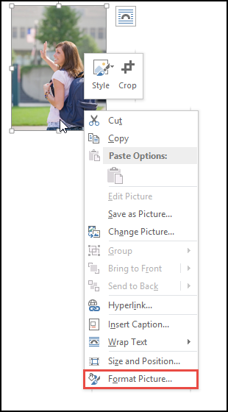
Alt Text
Insert the image.
Right click on the image and choose Format Picture.

Slide 13
Alt Text
Choose Layout & Properties (looks like a blue box with arrows).
Choose Alt Text.
Type the Alt Text into the Description box.

Slide 14
Word Documents – Tables
When inserting tables into your word document, use the table tools provided. This allows the screen reader to know that this is a table.
NOTE: use formatting tags inside of the table as well.

Slide 15
Tables
Click Insert tab.
Click Table.
Highlight the number of rows and columns you think you will need. Don’t worry, you can add or remove rows and columns later.
Left click in the bottom right box.

Slide 16
Tables
Enter the information into the cells.
Make sure to have a header row, column, or both as appropriate.

Slide 17
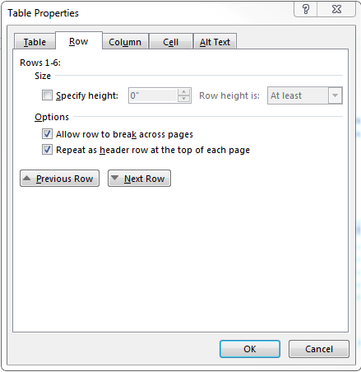
Tables
7) Right click on the table and choose “Table Properties”.
8) Under the “Row” tab, make sure “Repeat as header row at the top of each page” is checked.

Slide 18
Data Tables

Slide 19
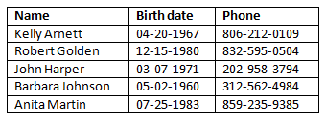
Data Tables

Slide 20
Microsoft Word – Descriptive Links
Avoid:
Click here to go to Blackboard.
Acceptable example:
Click http://blackboard.louisville.edu/ to go to Blackboard.

Slide 21
Best example:
Go to Blackboard.
If you want, you can include the URL:
Go to Blackboard (http://blackboard.louisville.edu/).

Slide 22
PDF Files and Journal Articles

Slide 23
Creating Accessible PDFs
Start with a properly formatted Word document.
Save as PDF
Save As PDF option
Acrobat Pro add-in
Print to PDF will NOT work
This does not work on Apple computers!

Slide 24
Journal Articles
Get from Library as HTML
Find online in accessible format (Google Scholar: http://scholar.google.com)
Use a different article

Slide 25
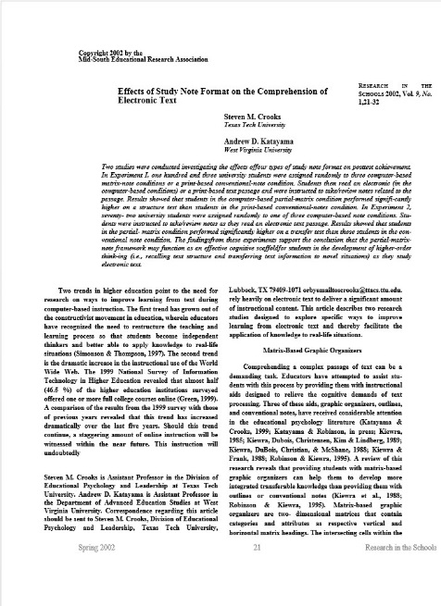
Read & Write Gold
Contact Colleen Gettys (colleen.gettys@louisville.edu) at the Disability Resource Center to get the software.
http://louisville.edu/delphi/resources/creating-accessible-courses

Slide 26
PowerPoint (PPT) Presentations

Slide 27
PPT Accessible Alternative
When creating slides, use the preformatted templates.
Create an equivalent document in Word. (See how-to document)
http://louisville.edu/delphi/resources/creating-accessible-courses

Slide 28
Audio and Video Clips

Slide 29
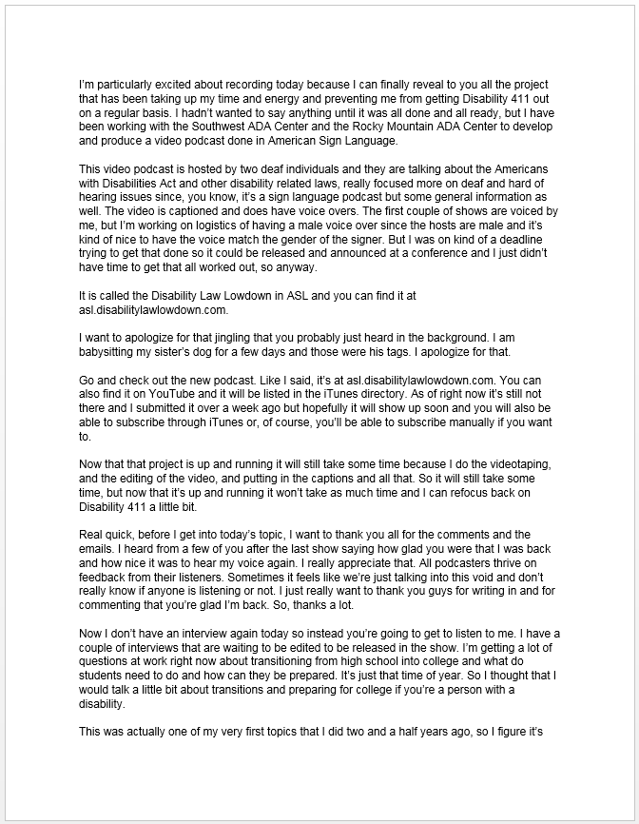
Audio
A transcript is sufficient.

Slide 30
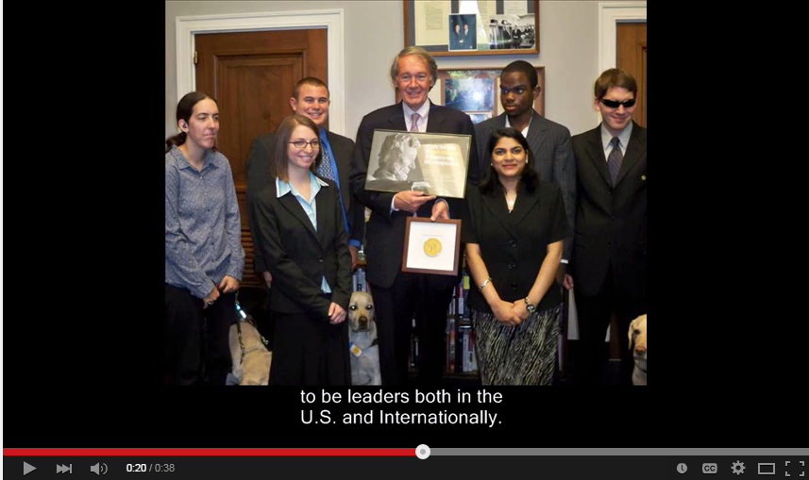
Video
Need synchronized captions
Look for videos with captioning
Caption in-house videos with YouTube
Pressure publishers to provide captioned videos

Slide 31
Best Practice
Don’t be afraid to use different types of content if it adds value.
Just make sure it is accessible, or an accessible equivalent is provided.

Slide 32
Contact Information
Beth Case
502-852-7689
beth.case@louisville.edu
http://louisville.edu/delphi/resources/creating-accessible-courses

