Slide 1
Gaining Ground with Universal Design for Learning
Beth Case
Program Manager for Digital, Emerging, and Assistive Technology

Slide 2
Overview
Review of UDL
Why you should collaborate with Disability Services
How can you get started?

Slide 3
Review of Universal Design for Learning (UDL)

Slide 4
Higher Education Opportunity Act of 2008
The term UNIVERSAL DESIGN FOR LEARNING means a scientifically valid framework for guiding educational practice that:
provides flexibility in the ways information is presented, in the ways students respond or demonstrate knowledge and skills, and in the ways students are engaged; and
reduces barriers in instruction, provides appropriate accommodations, supports, and challenges, and maintains high achievement expectations for all students, including students with disabilities and students who are limited English proficient.
Notes:
There’s no such thing as an “average” student. By planning a course for the imaginary “average” student, we’re not addressing the variability in every classroom.
Classes designed using UDL have enough flexibility to meet the needs of most, if not all, learners, reducing the need for individual accommodations and potentially expensive and time consuming retrofitting once a student with a disability registers for the course.

Slide 5
What UDL is NOT!

Slide 6
Three Principles of UDL
Provide multiple means of representation (“what” of learning)
Provide multiple means of action and expression (“how” of learning)
Provide multiple means of engagement (“why” of learning)
Notes:
Multiple methods of presenting information – text, video, graphics, audio. Presenting the same information in multiple ways benefits all students.
Multiple types of assignments and assessment – written, projects, presentations, multiple choice, matching, essay, etc.
Some students are engaged by spontaneity, others are stressed by this and need predictability, some like to work alone, others in groups. No type of engagement will meet the needs of everyone, so provide a variety.

Slide 7
Why Collaborate?

Slide 8
Roles
Disability Support Centers | Teaching and Learning Centers
Primary clients are students. | Primary clients are faculty.
Addresses course design and instruction after a student with a disability enrolls. | Addresses course design and instruction prior to the course being delivered.
Focus is on meeting individual needs of the student enrolled. | Focus is on overall best practices in teaching in order to meet the needs of all students.
Goal is help make quality education available to all students. | Goal is help make quality education available to all students.
Notes:
These are generalizations. Individual colleges may handle things differently.

Slide 9
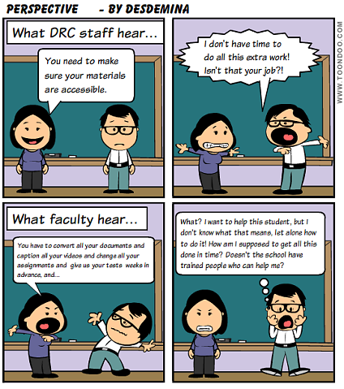
Has this happened to you?

Slide 10
What if you could do this?

Slide 11
Or if this happened?

Slide 12
Proactive Support
Accessibility presentations and modules included in training for online instructors:
Delphi U – 5 day face-to-face “boot camp”
Delphi U Online – 6 week online course
Survivor’s Guide – condensed training customized for a department upon request
One-on-one Consultation

Slide 13
Reactive support
Disability Resource Center emails faculty with students with sensory disabilities enrolled in an online course for the upcoming semester, letting them know Beth is available to help. Beth is copied on the email.
Beth reaches out to the instructor, offering to help make sure their class is accessible. This can include:
Teaching faculty how to make accessible materials.
Reviewing the course and materials for potential barriers.
Converting documents, captioning, etc.
Support is also available for face-to-face courses which has an online component.

Slide 14
How can you get started?

Slide 15
Do your research
Who provides faculty training at your campus?
What kind of workshops and training do they offer?
What support is available for online instructors?
Course design
Help with Learning Management System
If your campus has instructional designers, where are they housed?

Slide 16
First steps
Research the Disability Resource Center to familiarize yourself with their activities. Learn as much as you can about its history, culture, and needs.
Are there programs or events it makes sense for you to co-sponsor?
Are there programs or events you’d like to do that make sense to develop together?
What can you offer to the Disability Resource Center?

Slide 17
Schedule a meeting
At the meeting, establish shared goals
Example: Making it as easy as possible to provide quality education to all students.
Identify a problem that affects both organizations
Example: Faculty don’t know the simple things they can do to make a course accessible while creating it, resulting in a lot of scrambling once a student with a disability registers.
Suggest ideas that address the problem, emphasizing what you can do.
Examples: Offer a workshop hosted through the Teaching and Learning Center, DRC to their instructional designers, co-create handouts that can be housed on resources page.

Slide 18
Action items
Decide on 1-2 specific activities you will collaborate on.
Figure out if there are listservs, organizations, or conferences in each others’ fields that would be beneficial to join. You might co-sponsor someone to attend a conference such as Accessing Higher Ground.
Have regular meetings about what each office is doing – it’s important to cultivate the relationship.

Slide 19
Contact Us
Beth Case
University of Louisville
Beth.case@Louisville.edu
502-852-7689

