Slide 1
Makerspace: The Future of Music
Anthony Paganelli
WKU Elizabethtown/Ft. Knox,
Part-Time Regional Campus Librarian
anthony.paganelli@wku.edu
270-706-8596

Slide 2
Makerspace Presentation
Introduce the concept of makerspaces.
Understand the goal of makerspaces in education.
Relax and enjoy!!!

Slide 3
Makerspace Introduction
Erin Fisher, Library Program Manager at Grand Valley State University, “A makerspace is a place where people come together to design and build projects. Makerspaces typically provide access to materials, tools, and technologies to allow for hands-on exploration and participatory learning”
“They foster experimentation, invention, creation, exploration, and STEM learning” (IMLS, 2012).

Slide 4
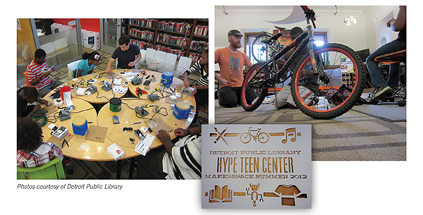
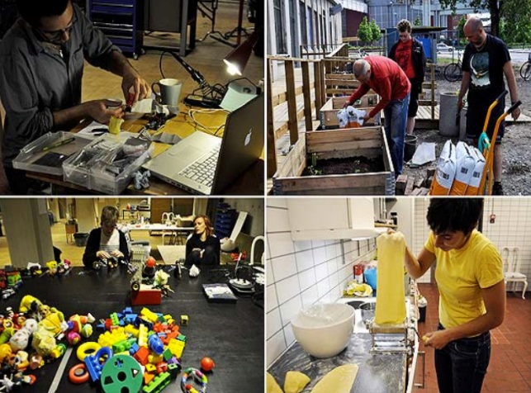
View of various Makerspaces
All makerspaces will differ, due to the physical space and the content provided.
A makerspace allows participants an opportunity to receive hands-on learning, collaboration with mentors and a diverse community, while using critical thinking in a creative environment.

Slide 5
Makerspace concept
A makerspace should provide students with a goal to reach, such as a finished product.
During the project, the student should experience interdisciplinary studies while completing the project.
Students should collaborate with others during the project.

Slide 6
Makerspaces in Education
Curriculum
Makerspace
Define the main subject that students are learning.
Think of other subjects that pertain to the main subject.
For example, an English composition course
Provide a project that requires a final result based on the main subject.
Incorporate other tools to supplement the main subject theme of the curriculum
A project for the students, is to write a story, design a book using technology, and construct the book using materials provided.

Slide 7
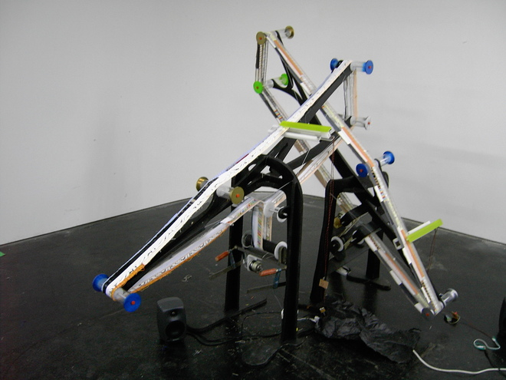
The Future of Music Makerspace

Slide 8
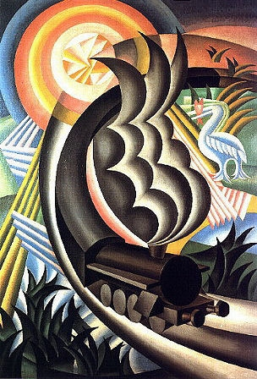
The Futurist Movement in Music
100 years ago, Luigi Russolo (1883-1947), a futurist artist and composer, wrote a letter to a friend establishing the ‘Art of Noise’ manifesto for futurist musicians and composers.
He notes that 20th century traditional music struggled to keep the interest of music listeners, due instrumentation and techniques. Basically, music in general was boring.
His idea was to embrace and use noises for musical compositions.

Slide 9
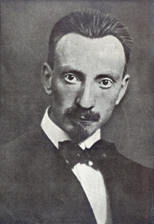
Purpose of Manifesto
Luigi Russolo’s Theory:
Composers of the time were already trying to break the norm of music harmony through atonality (No tonal center or key signature; musical dissonance) compositions.

Slide 10
Tonal Center
Tonal center means music that has a primary pitch.
Typically, in tonal music there are seven pitches and six will lead towards one pitch or the tonal center. Example a Mozart composition.
Atonality – Means no pitches leading to a typical tonal center. Example Arnold Schoenberg

Slide 11
Purpose of Manifesto
Luigi Russolo’s Theory:
Composers of the time were already trying to break the norm of music harmony through atonality (No tonal center or key signature; musical dissonance) compositions.
Traditional orchestra instruments had reached their limit of sounds.

Slide 12
Musical instruments and form
Musical instruments had not changes in centuries.
Mostly stringed instruments.
Various Brass and Woodwind instruments introduced in 1600’s to late 1800’s.
Percussion becomes widely used in orchestras during the early 1800’s.
Overall, no major change to instruments or sounds.
Musical form and structure had not change significantly in centuries.
Basically, a Mozart Sonata can be easily compared to a modern pop song today.
Mozart died December 5, 1791. That is over two hundred years of same harmonies and structures.

Slide 13
Purpose of Manifesto
Luigi Russolo’s Theory:
Composers of the time were already trying to break the norm of music harmony through atonality (No tonal center or key signature; musical dissonance) compositions.
Traditional orchestra instruments had reached their limit of sounds.
Noises could produce more pitches (standard Western musical scales), as well as changing rhythmic patterns.
New instruments could control pitches through the use of technology that would allow for more controlled performances.

Slide 14
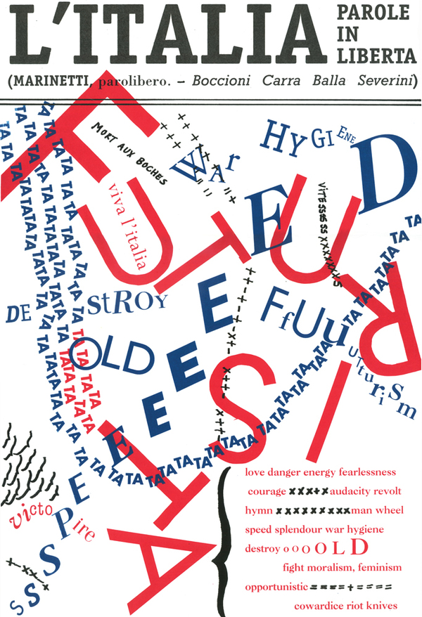
A Futurist Orchestra
Roars, claps, noises of falling water, driving noises, and bellows.
Whistles, snores, and snorts.
Whispers, mutterings, rustlings, grumbles, grunts, and gurgles.
Shrill sounds, cracks, buzzing, jingles, and shuffles.
Percussive noises using metal, wood, skin, stone, baked earth, etc.
Animal and human noises; shouts, moans, screams, laughter, rattling, and sobs.

Slide 15
The Intoner
Russolo and fellow futurist painter, Ugo Piatti stand next to their Intoner, which was an instrument they created to produce 27 different noises. The machine included hisses, scrapes, explosions, etc. The premier for the machine was on June 2, 1913 in Modena. The composition was four noise networks that were Awakening a Capital, Meeting of Automobiles and Airplanes, Dining Time at the Casino Terrasse, and Skirmish at the Oasis.

Slide 16
Anything Goes!!!!!!!!
“Music for One Apartment and Six Drummers”
During this makerspace session, you cannot fail!!!!
Have fun and enjoy!

Slide 17
Let’s Create Music of the Future
Design and create musical instruments. Anything goes. Landfillharmonic
Collaborate with others to compose a composition. Simplest definition of music is sound that is grouped together by rhythmic patterns.
The composition needs to be approximately 3 minutes in length and form a melodic or harmonic theme for an ABA style. Themes can also be determined through dynamics (soft, loud, accented, etc.) or rhythmic patterns.
Rehearse and then record the ensemble. Finally, upload the video to YouTube.

Slide 18
Creating an Instrument
The basic element of an instrument is that it produces a sound.
What type of sound is made varies depending on the design of the instrument.
All instruments will produce a sound wave.

Slide 19
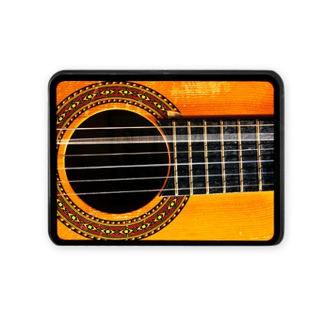
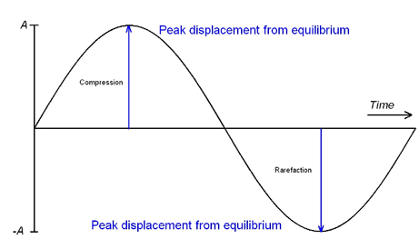
How a Musical Instrument Works
The goal of a musical instrument is to produce a sound.
Sound is a type of energy that moves through material and causes it to vibrate.
Vibrate means that a material moves back and forth.
Sound wave is the pattern in which sound energy travels.
Frequency is the number of sound waves in a given time.
Musical pitch is sounds that are high in frequency or low in frequency.
Musical note refers to a specific pitch.
Education.com

Slide 20
Musical Form ABA
Music has numerous forms that allow listeners to maintain focus and comprehend the composition.
For the makerspace ABA for will be used. The A section will be an overall main theme, while the B section will be a different theme, and finally the A section returns with the main them and concludes.

Slide 21
Record and Upload
Once the composition is complete and the ensemble is ready to record, participants can use the iPad to record the ensemble.
After the video is recorded, if the group needs to edit they may do so.
Finally, establish an ensemble name, name the composition, create an YouTube account, and upload the video.

Slide 22
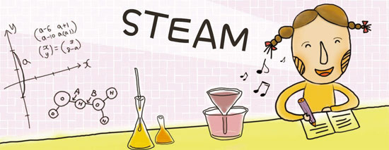
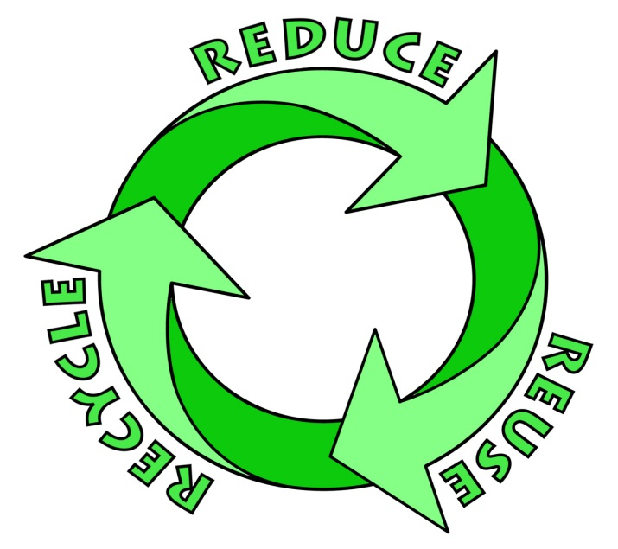
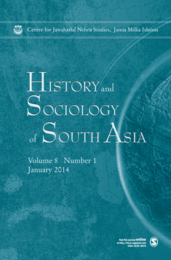
Things you learned
STEAM and more!
Science – Physics of sounds, through an intro to sound waves.
Technology – Use of different tools to make instruments, recorded and uploaded music to YouTube.
Engineering - Through the use of creating and designing instruments
Art – Learned music form, theory, and composition, as well as basic art.
Math – Used during the process of constructing the instrument.
History – Learned about the futurist movement and social issues of the time period.
Sociology – The Landfill Harmonic
Environmental concerns – Again the Landfill Harmonic.

